Slide 1
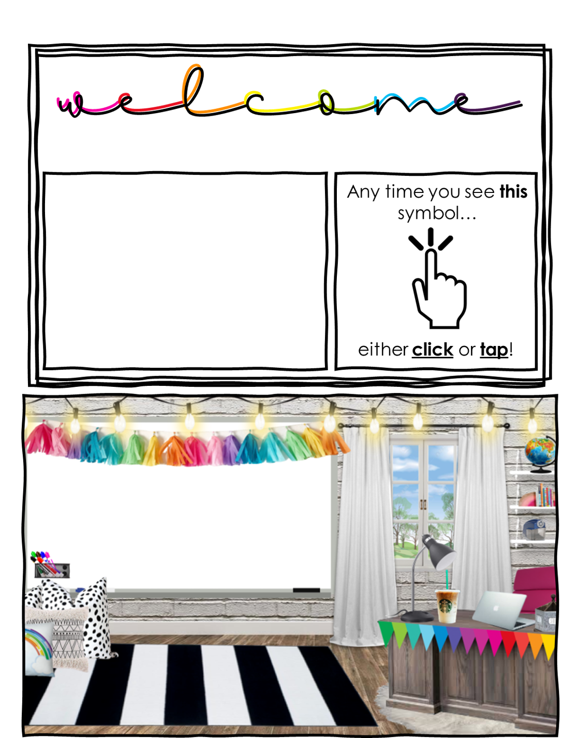
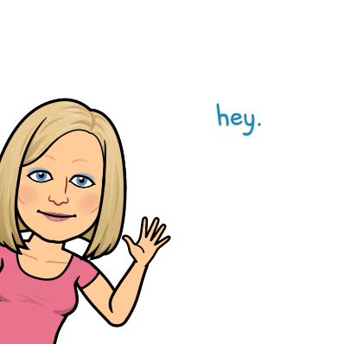
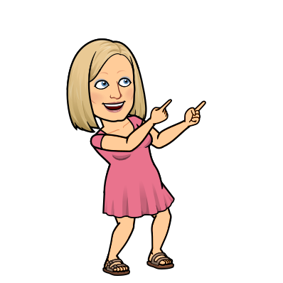

to 4th Grade
My name is
Mrs. Silvers
About Me

Slide 2


About Me
About Me
Who am I?
My Hometown
My family
My favorite things
My promise to you
Contact Me

Slide 3
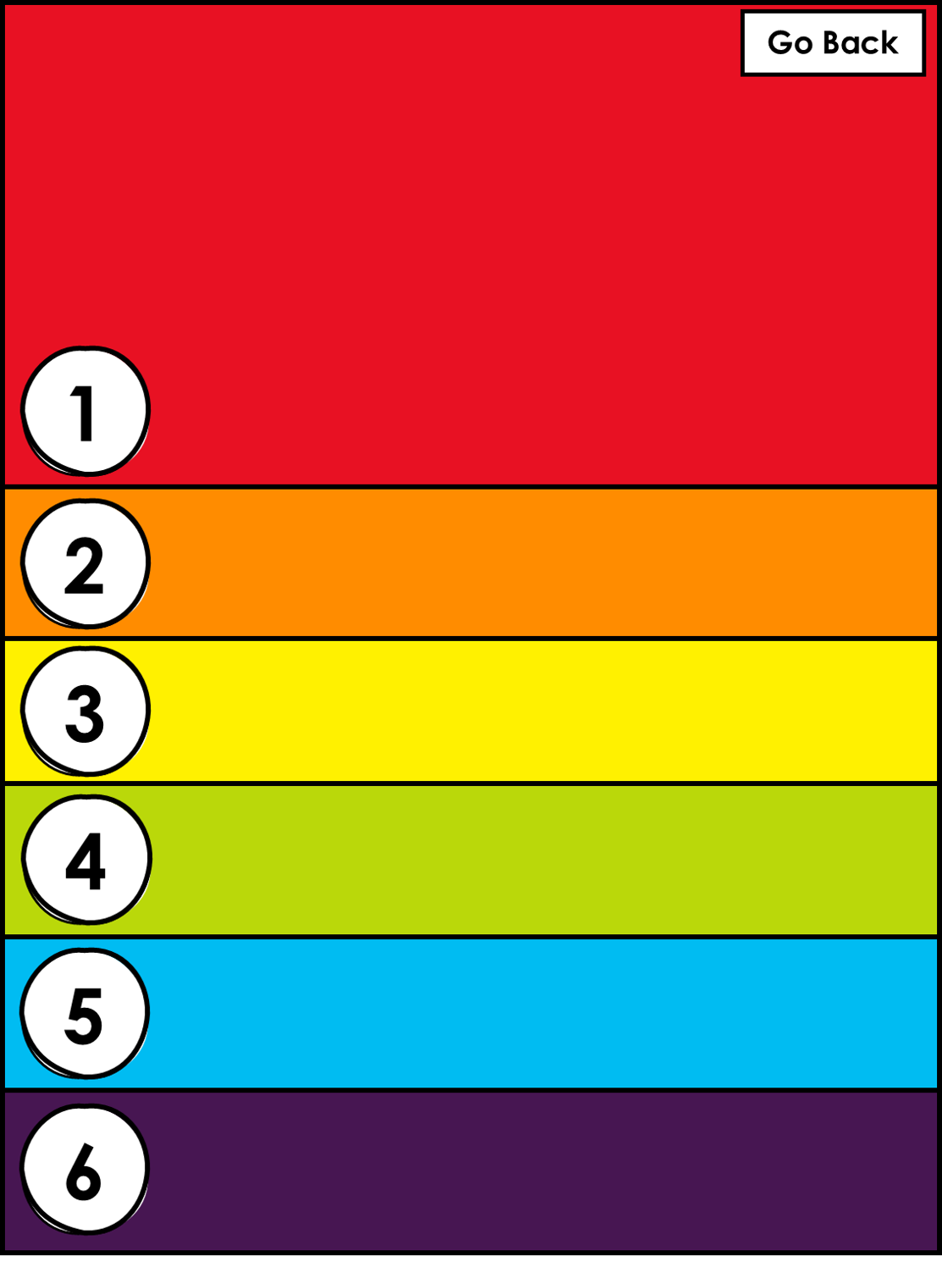
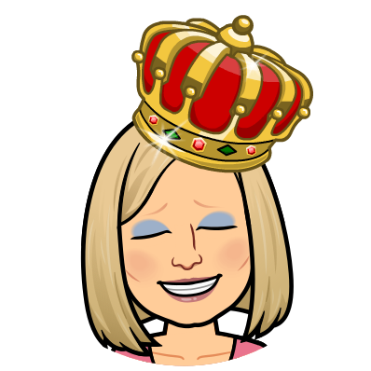
Elizabeth Silvers, but I go by Libby, except for my husband, Bob, who refers to me as Queen Elizabeth Ann the 1st. I am a mother of 3, 2 boys and a girl. My oldest son, Justin, went to be with the Lord at 28 years old. My son Kevin is a welder in Tennessee, and my daughter Jennifer is a pet groomer at Pet Smart in Chattanooga. I started teaching Pre-K while working on my teaching degree in 1992. I recieved my Bachelor’s in 2001, and my Master’s in 2009.
Who am I?
My Hometown
My family
My favorite things
My promise to you
Contact Me

Slide 4

I was born in Kalamazoo! I grew up in a small town called Gobles, where I lived and went to school from Kindergarten through the 12th grade. I went to school and played in the snow. I learned to drive in the snow, and now… I hardly ever see the snow. I moved to Chattanooga at 19 years old when I married, then moved to Hartselle in 2015. I have come to visit Hartselle every year since I was young to visit my family on my dad’s side. I always loved Hartselle and hoped to move here some day and I did! I don’t know about you, but I love living in Hartselle, Alabama!
My Hometown
My family
My favorite things
My promise to you
Contact Me

Slide 5

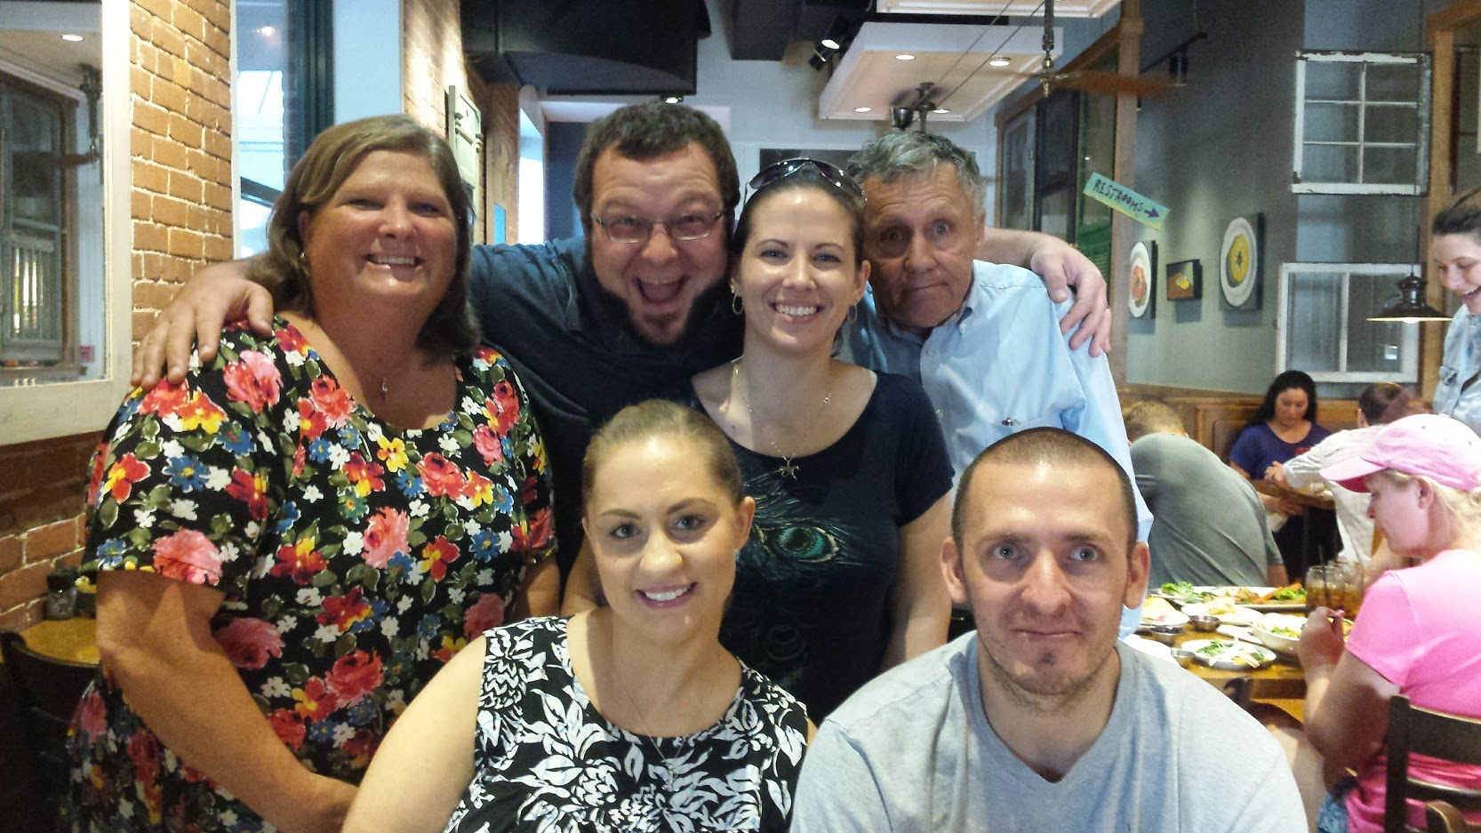
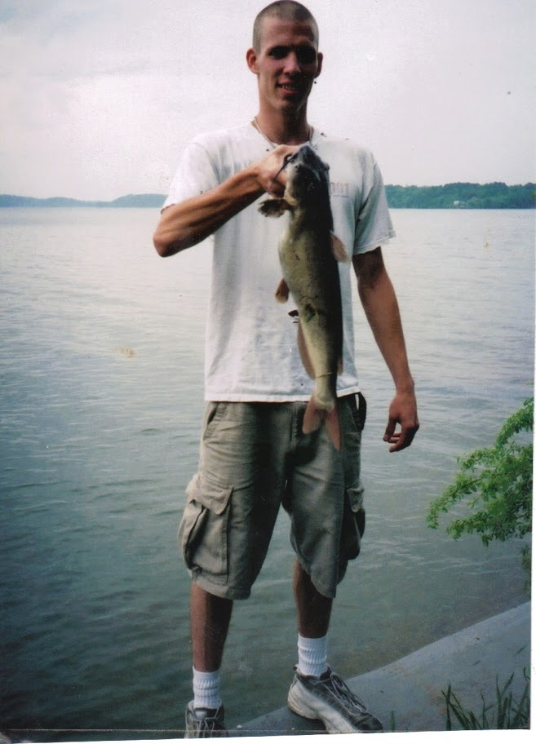
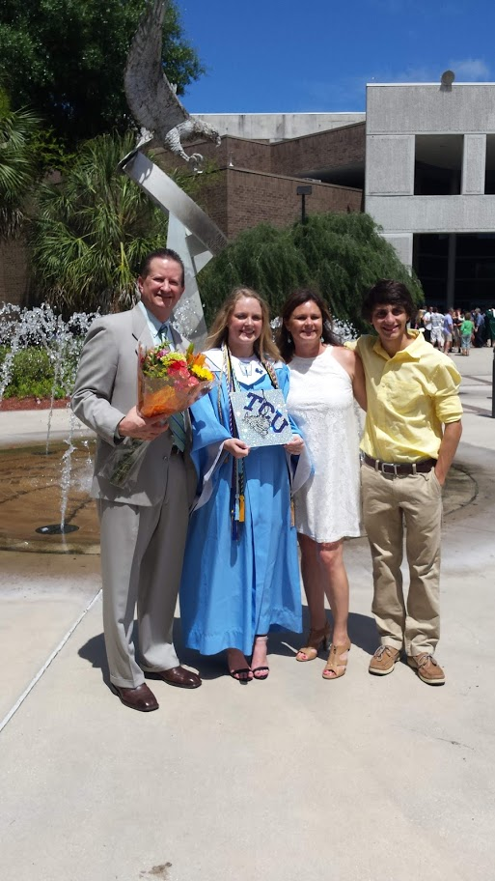
I am a mother of 3, 2 boys and a girl. I married Bob Silvers on a very cold day under the gazebo in LaFayette, Georgia, January 22, 2013. It was 22 degrees, burr. I was blessed to have my 2 children and their spouses at my side, even though it was so cold. I now have a step daughter and son in law, along with 2 amazing grandchildren who just graduated from college in 2019. Taylor is a nurse at Vanderbilt Hospital in Nashville, Tennessee, and Brandon is a finance officer at a mortgage company in Jacksonville, Florida..
My family
My favorite things
My promise to you
Contact Me

Slide 6

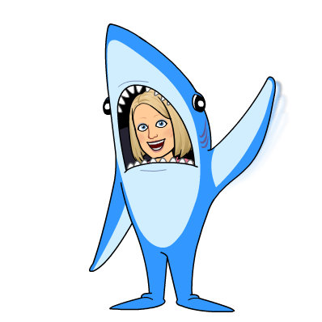

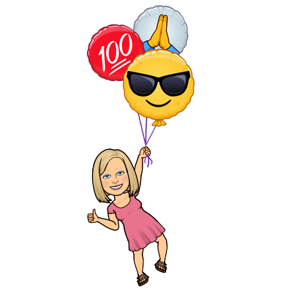
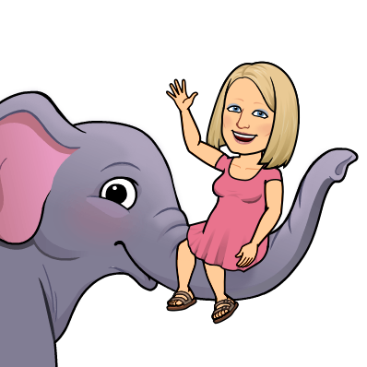

I love telling fun stories and writing poetry. Horton is one of my favorite book characters, because he is faithful and kind. I like making up rhymes and songs about anything and everything. I enjoy reading books aloud with character voices and excitement. I wrote and published on Amazon my first book,
Mrs. Silvers Gets a Snow Day.
I also love fish! I have a great tank in my living room, one in the classroom, and a pond in my yard with big goldfish in it.
My kids are my very favorite things on Earth. I love being a mom!
But, my favorite thing in the whole wide world is Jesus! I want to please the Lord with all I do and say. It is my relationship with God that drives my thoughts and actions, though I know sometimes I fail to do what He would rather I do, I know that He knows my heart, and doesn’t give up on me, and always loves me!
My favorite things
My promise to you
Contact Me

Slide 7


I Promise…
I promise to show you respect.
I promise to make learning fun and informative.
I promise to expect your best, and give you my best every day.
I promise to forget yesterday's poor choices, and not hold a grudge.
I promise to work with your parents to do what is best for you in my class.
I promise not to give up on you.
I promise to do everything I can to make this your best year ever!
Mrs. Silvers
My promise to you
Contact Me

Slide 8



email me:
elizabeth.silvers@hartselletigers.org
contact me on Class Dojo
write a note
Contact Me

